Slide 1


Lab In Data Analysis
Avishay Bar | 316165984
Liad Garbois | 206714958

Slide 2







Road Map
Introduction
Dataset Overview
Data Preparation & Cleaning
General Analysis
Deep Analysis
Insights & Conclusion

Slide 3
Road Map
Introduction
Dataset Overview
Data Preparation & Cleaning
General Analysis
Deep Analysis
Insights & Conclusion

Slide 4
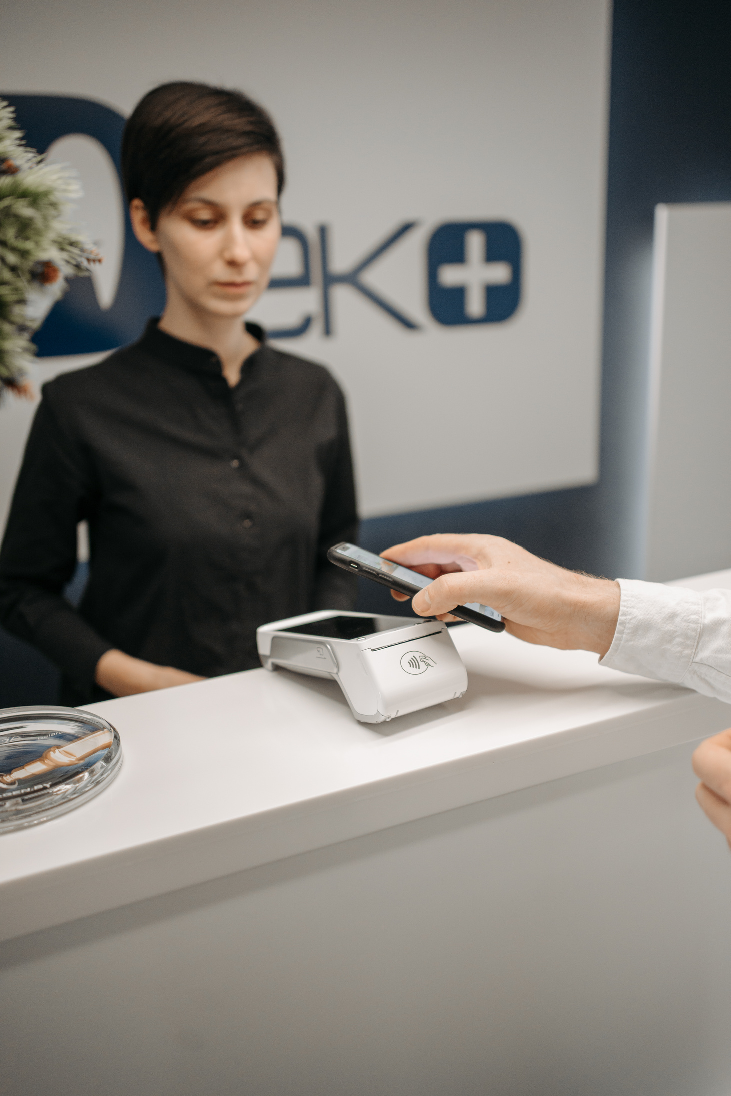


Introduction
After the COVID-19 pandemic, mobile phones and laptops became essential tools for everyone, regardless of their occupation.
Many brands produce laptops and mobile phones, each featuring its own unique processor.
Nowadays, social media influencers earn a living using only their mobile phones and laptops. Moreover, these devices store much of people's sensitive and personal information.
Consumers often choose devices based on memory specifications, making it a key factor in purchasing decisions. Cloud services help, but many users still prefer ample local storage for speed, privacy, and offline access.

Slide 5
Road Map
Introduction
Dataset Overview
Data Preparation & Cleaning
General Analysis
Deep Analysis
Insights & Conclusion

Slide 6
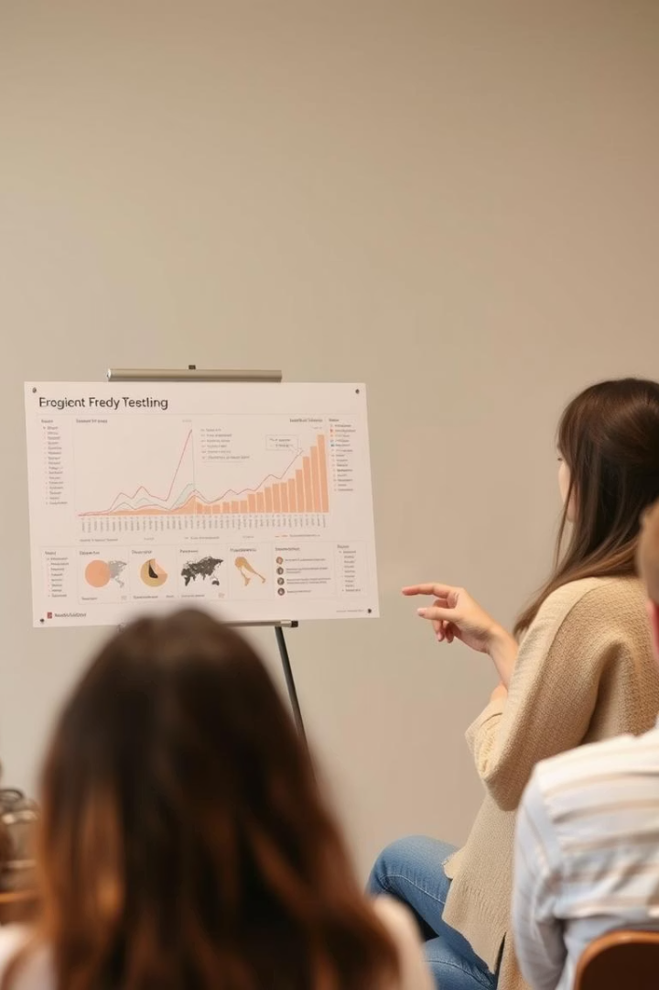


Dataset Overview
Dataset Theme
Simulated sales transactions for mobile phones and laptops
Data Included
Product specifications, Customer details and Sales information
Size
50,000 rows and 16 columns.

Slide 7

Dataset Overview
Product Information
Product
Brand
Product Code
Product Specification
Type of product (Mobile Phone / Laptop).
Various brands like Apple, Samsung, Dell, Lenovo, OnePlus, etc.
Unique identifier for each product.
Brief description of the product features.

Slide 8
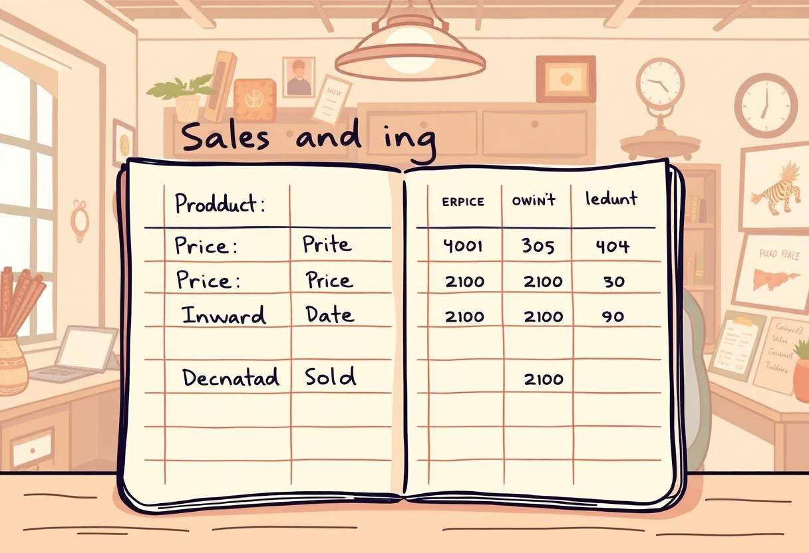
Dataset Overview
Sales & Pricing Details
Price
Inward Date
Dispatch Date
Quantity Sold
Cost of the product (randomly generated).
Date when the product was received in stock.
Date when the product was sold/dispatched.
Number of units sold per transaction.

Slide 9
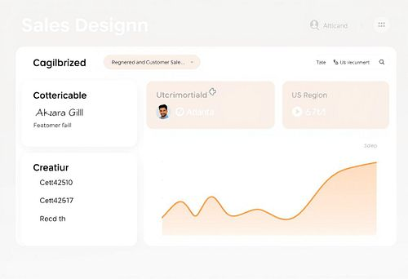
Dataset Overview
Customer & Location Details
Customer Name
Customer Location
Region
Randomly generated customer names.
City of the customer.
Sales region (North, South, East, West, Central).

Slide 10

Dataset Overview
Technical Specifications
Core Specification
Processor Specification
RAM
Includes processor models like i3, i5, i7, i9, Ryzen 3-9 (For Laptops).
Includes processors like Snapdragon, Exynos, Apple A-Series, and MediaTek Dimensity (For Mobiles).
Randomly assigned memory sizes (4GB to 32GB).
ROM
SSD
Storage capacity (64GB to 1TB).
Additional storage (256GB to 2TB), "N/A" for mobile phones (For Laptops).

Slide 11
Road Map
Introduction
Dataset Overview
Data Preparation & Cleaning
General Analysis
Deep Analysis
Insights & Conclusion

Slide 12
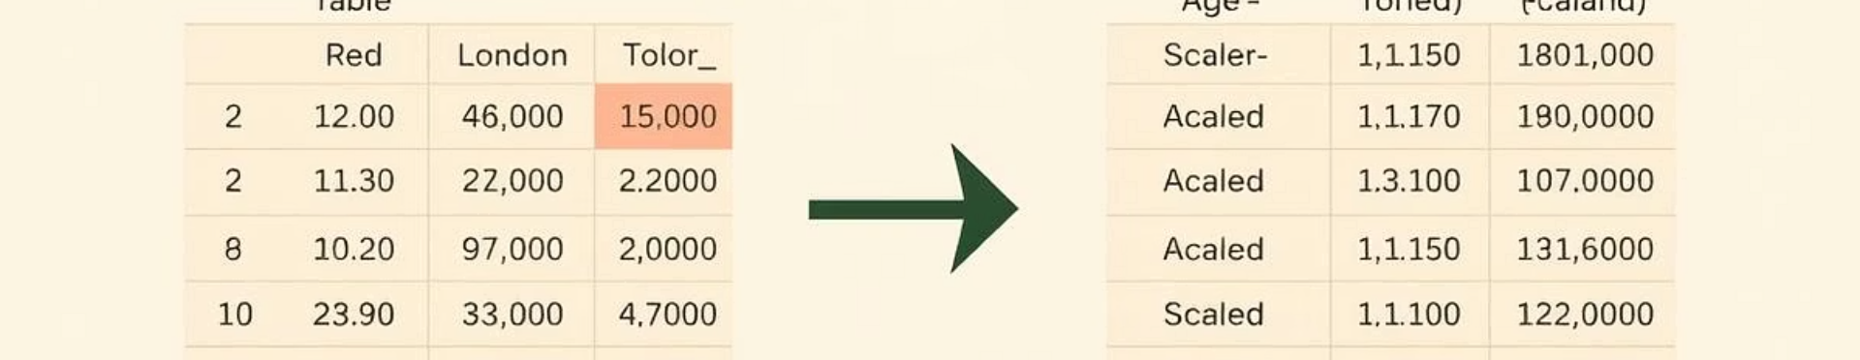
Data Preparation and Cleaning
Handle Missing Data
1
Since missing values appeared only in specific columns related to either mobiles or laptops, we split the base DataFrame into two separate DataFrames - one for mobiles and one for laptops.
Column Filtering
2
Removed unnecessary columns for streamlined analysis.
Data type conversion
3
converted relevant columns to appropriate data types - such as transforming date columns to datetime format and memory values to numeric types.

Slide 13
Road Map
Introduction
Dataset Overview
Data Preparation & Cleaning
General Analysis
Deep Analysis
Insights & Conclusion

Slide 14
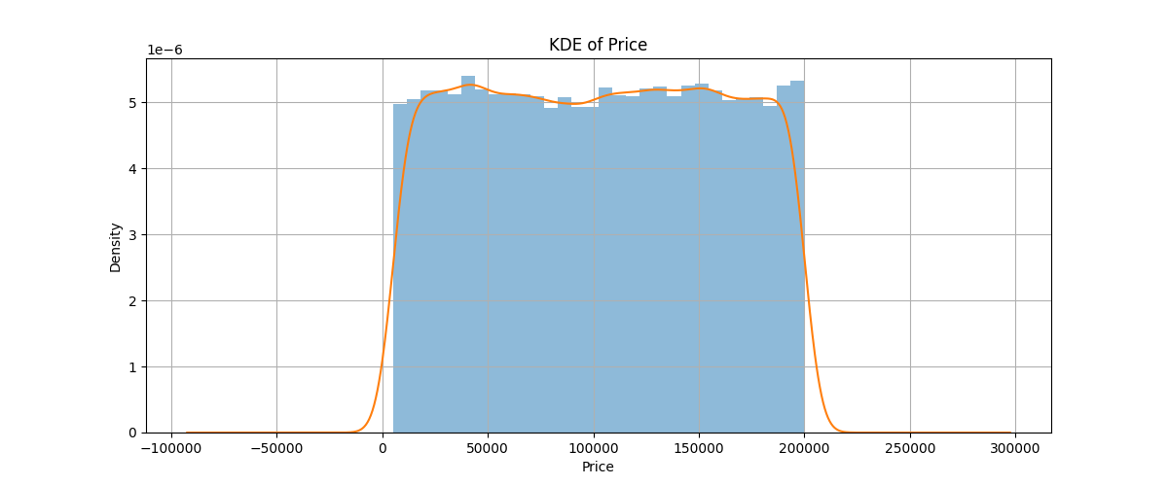
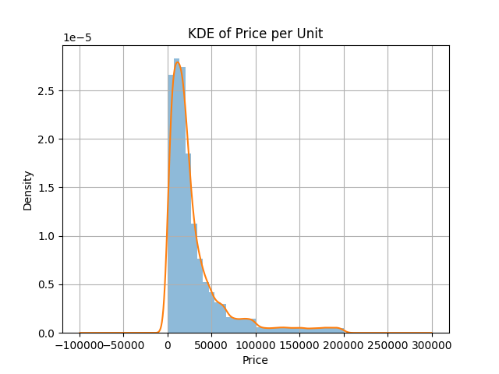
Descriptive Statistics
 | Quantity Sold | Transaction Price | Product Price
Mean | 5.51378 | 102641.407080 | 30051.675203
Standard deviation | 2.88101 | 56363.550361 | 35002.698708
Min | 1.0 | 5008.0 | 503.2
Max | 10.0 | 199999.0 | 199999.0
Median | 6.0 | 103072.0 | 18621.83
Variance | 8.300216 | 3.1768e+09 | 1.225189e+09

Slide 15
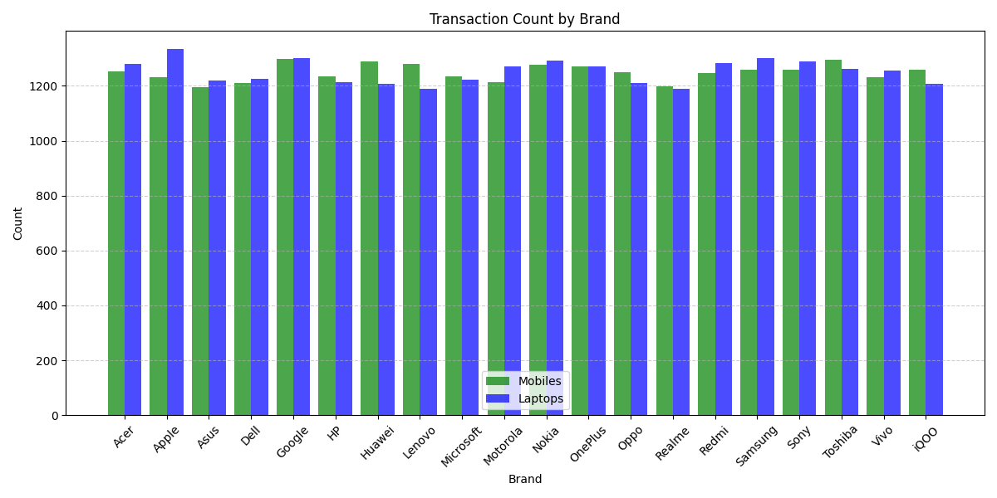
Descriptive Statistics

Slide 16
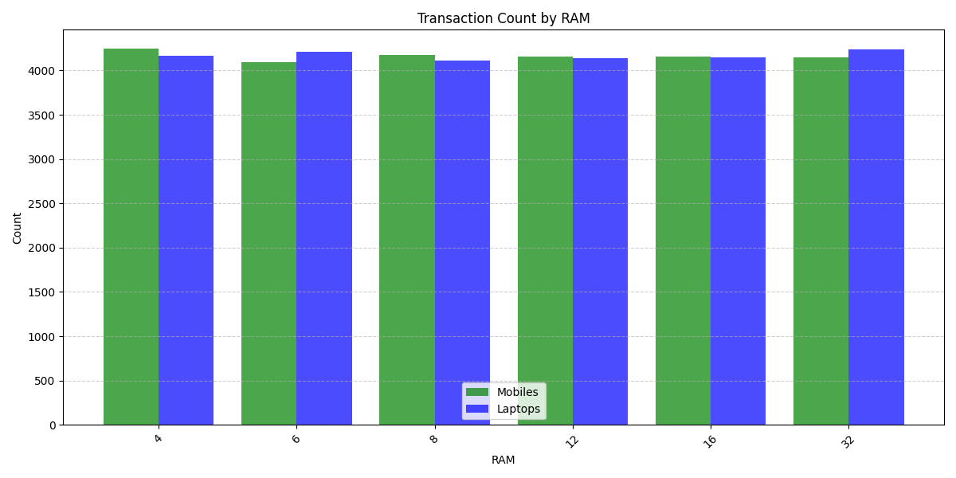
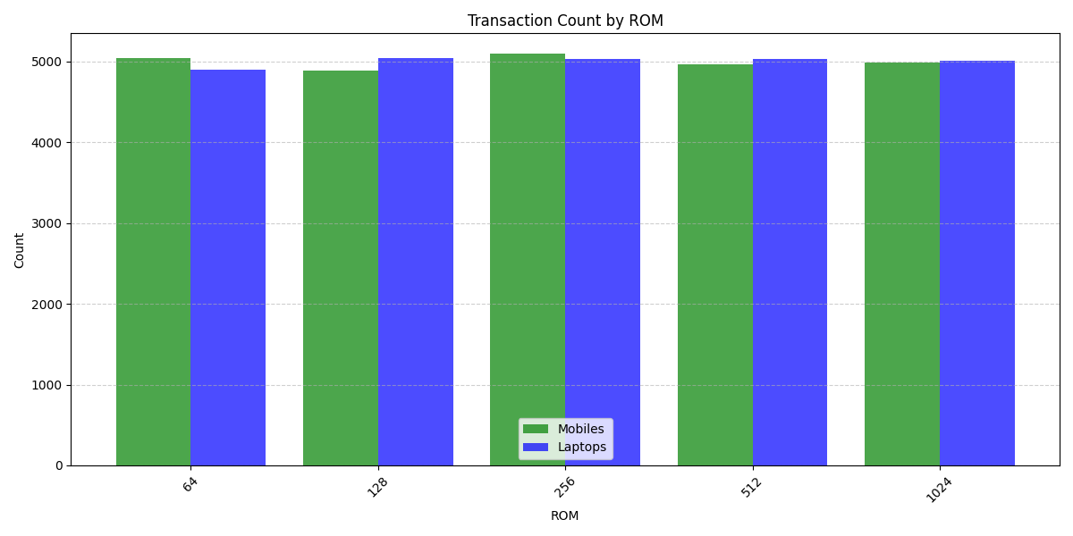
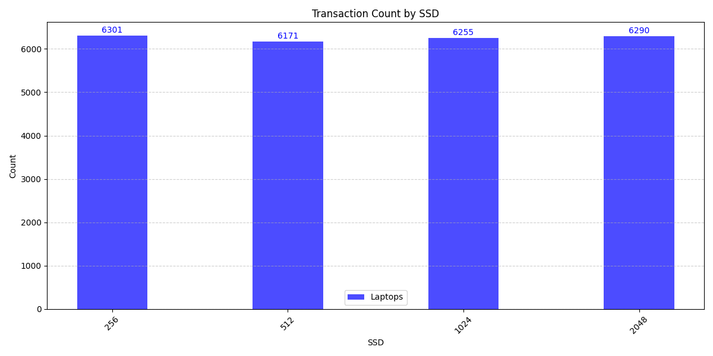
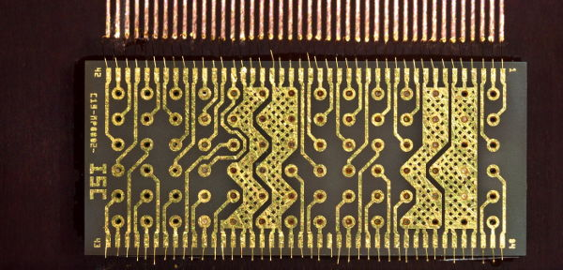
Descriptive Statistics

Slide 17
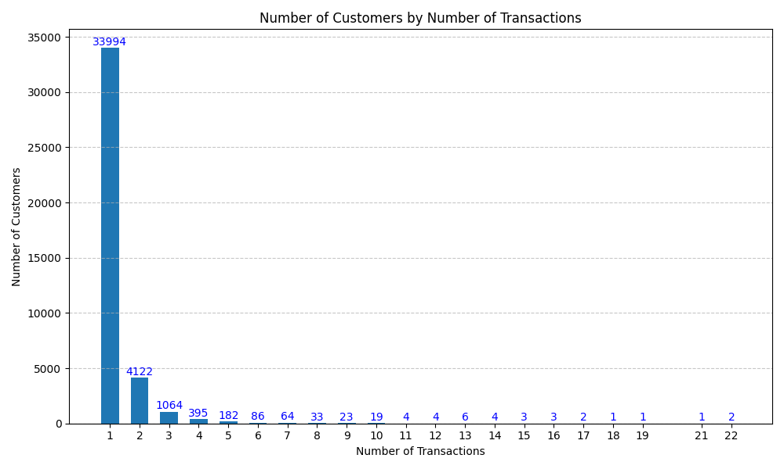
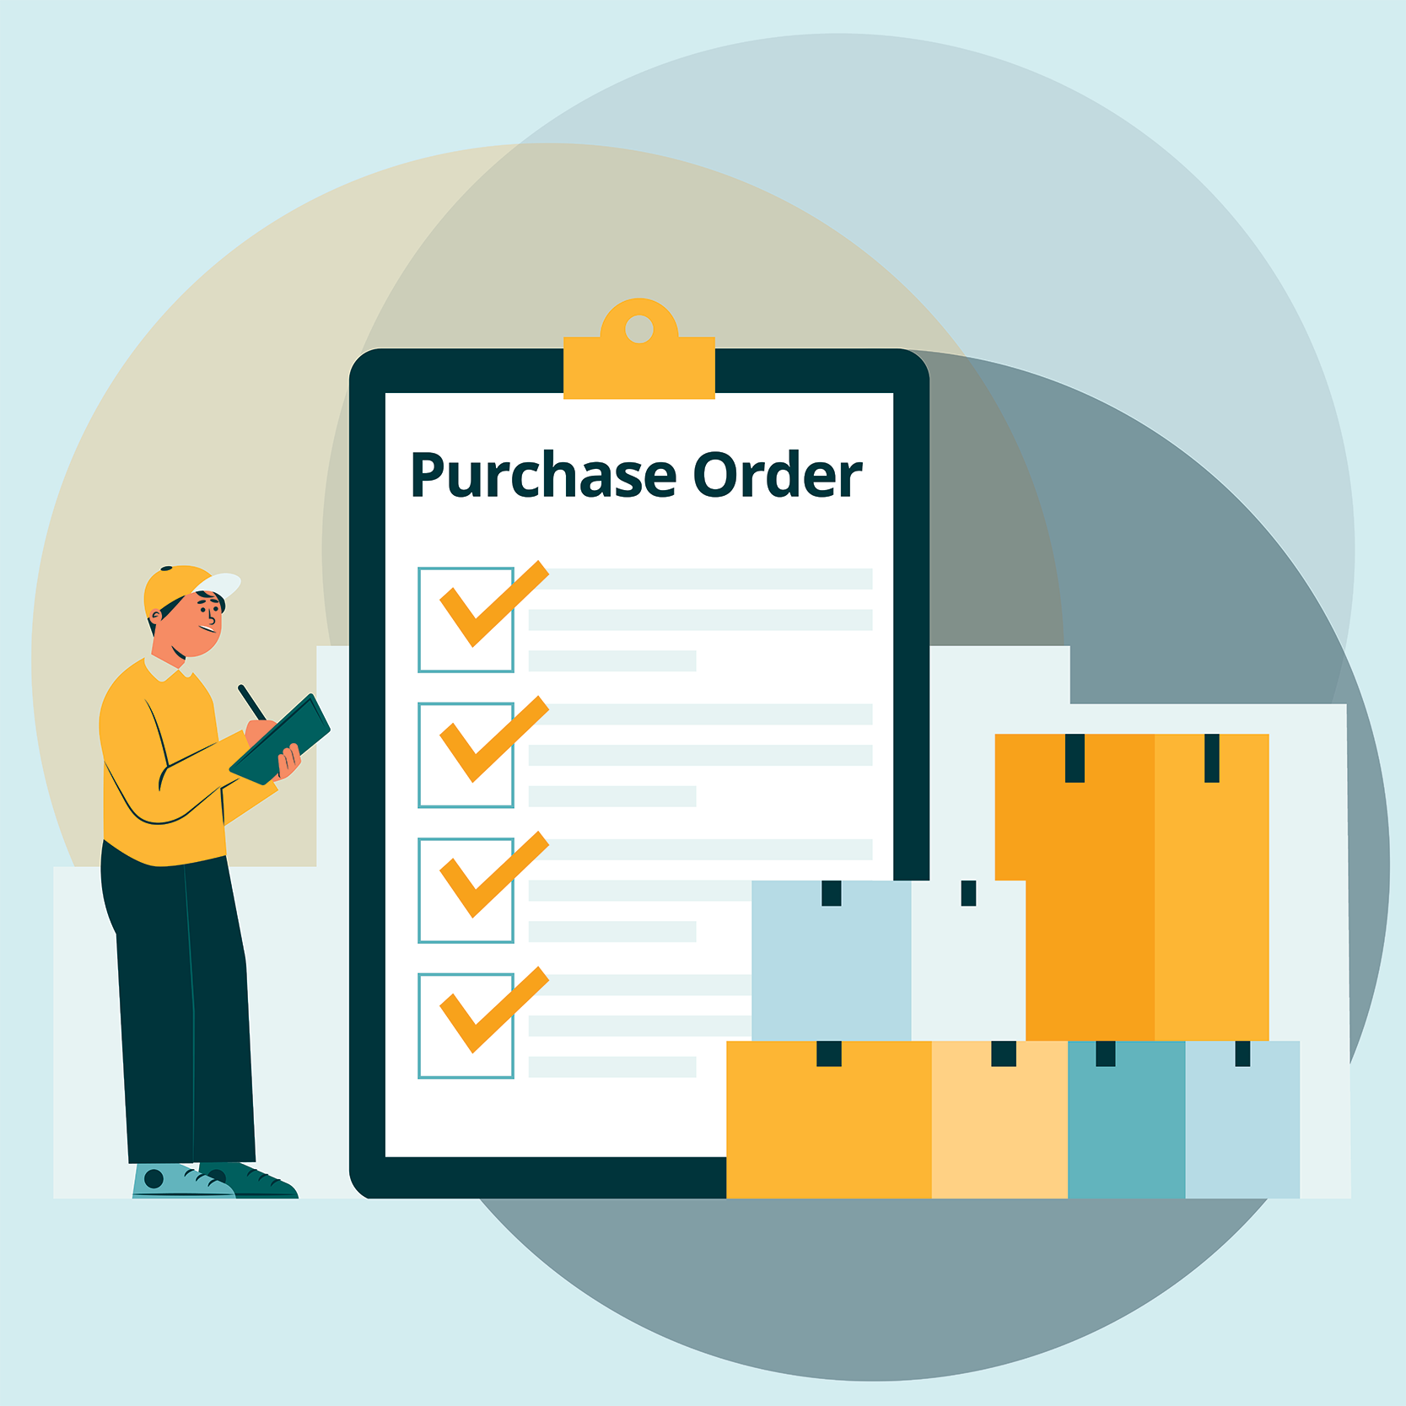
Descriptive Statistics

Slide 18
Road Map
Introduction
Dataset Overview
Data Preparation & Cleaning
General Analysis
Deep & Complex Analysis
Insights & Conclusion

Slide 19

Key Objectives
1
Identify Regional Transaction Patterns
Analyse how sales volume and product preferences vary across different regions.
2
Analyse Processor and Core Popularity Over Time
Track trends in the popularity of processor types and core specifications across time.
3
Assess Brand Financial Profit Over Time
Analyse and compare the financial profit of each brand over time, considering the quantity sold in each transaction.

Slide 20
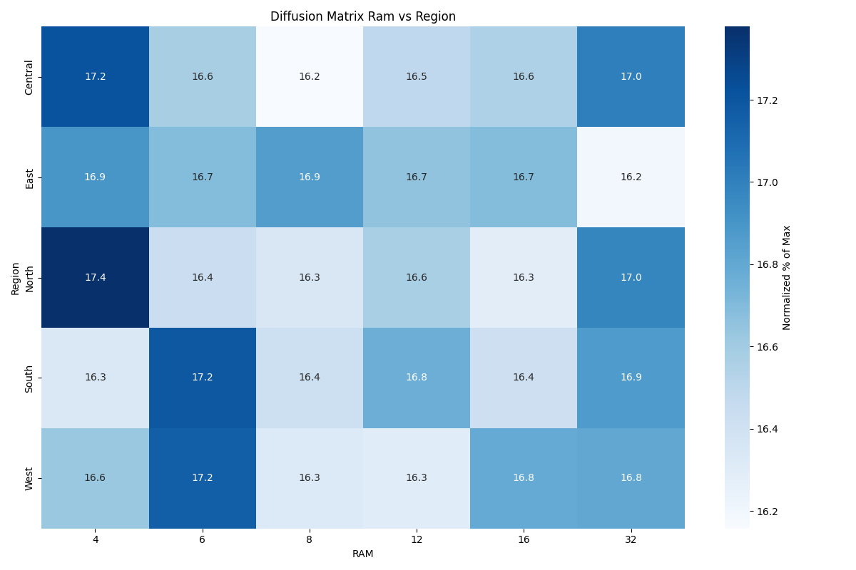

Identify Regional Transaction Patterns

Slide 21
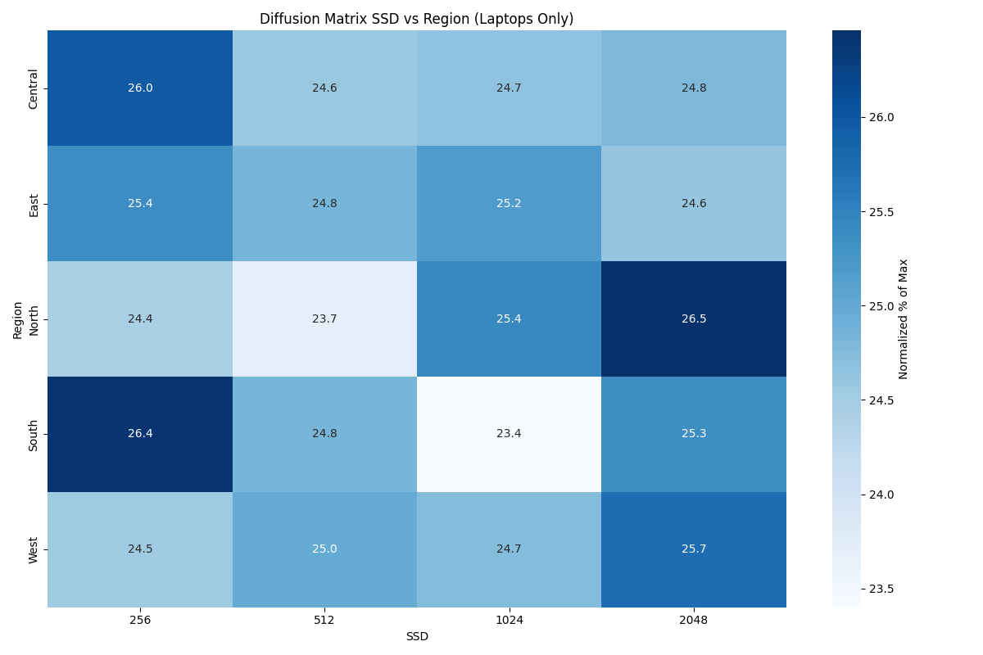
Identify Regional Transaction Patterns

Slide 22
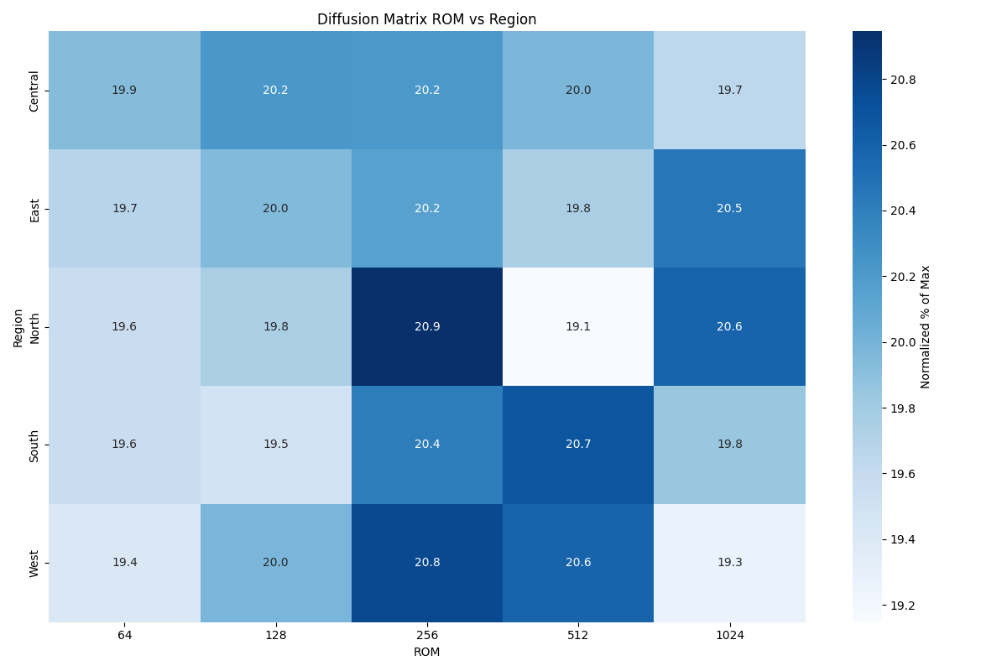
Identify Regional Transaction Patterns

Slide 23
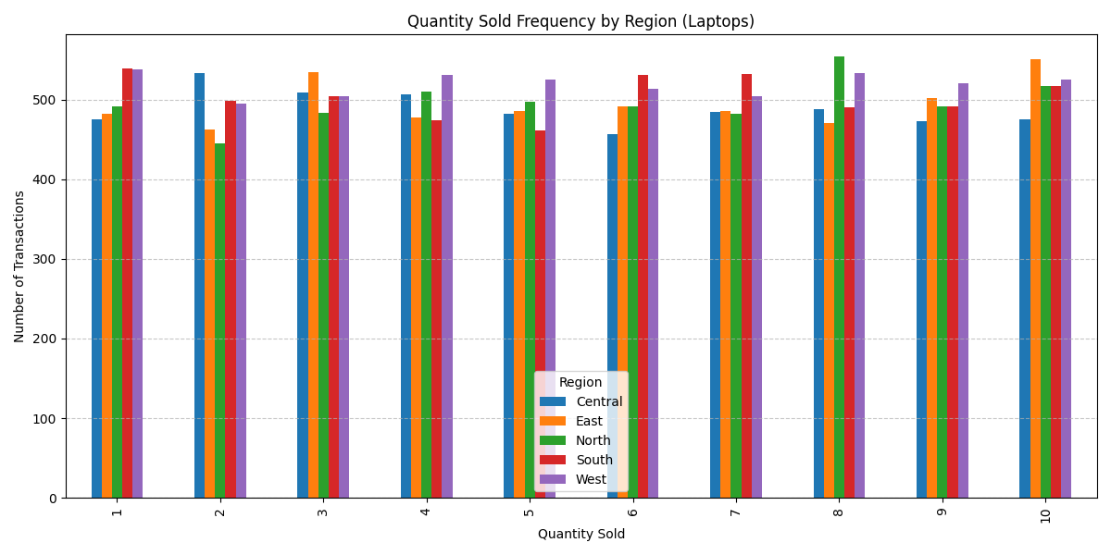
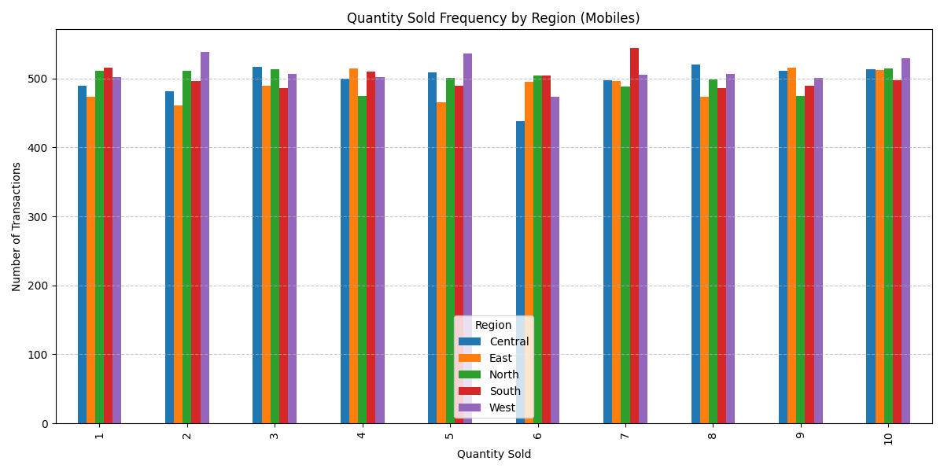
Identify Regional Transaction Patterns

Slide 24
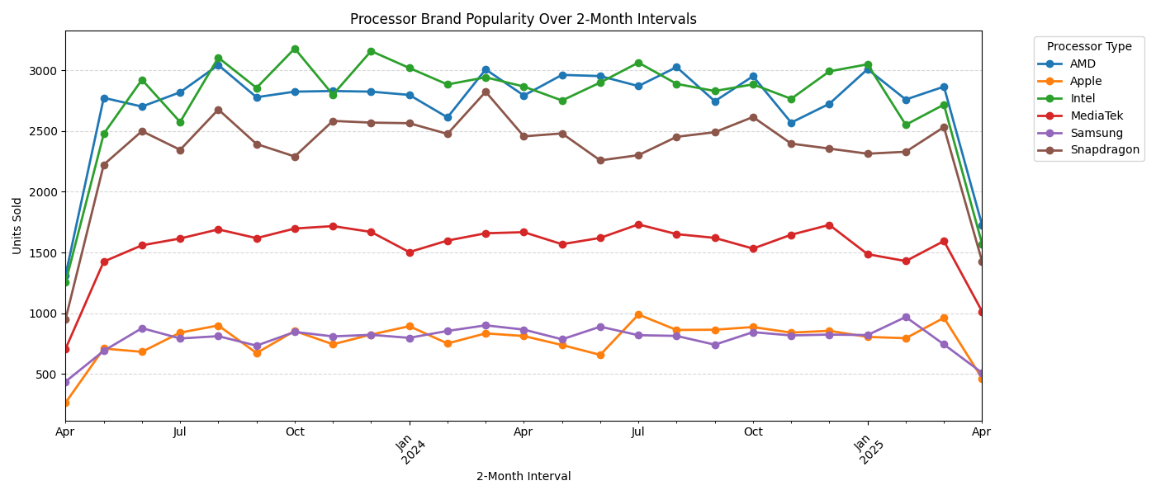

Analyse Processor and Core Popularity Over Time

Slide 25
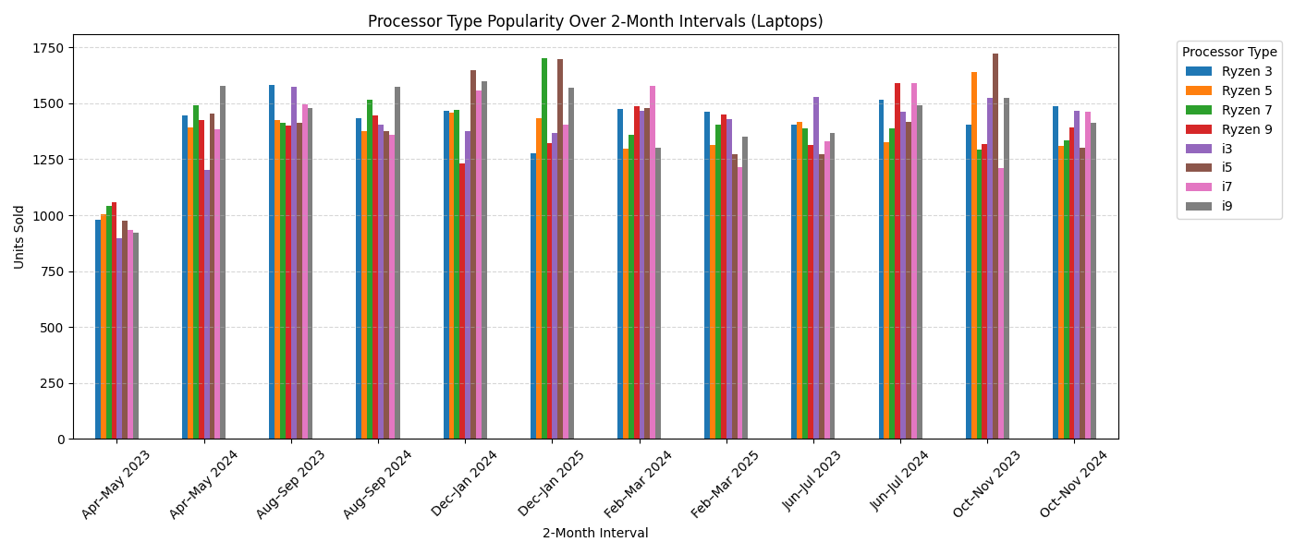

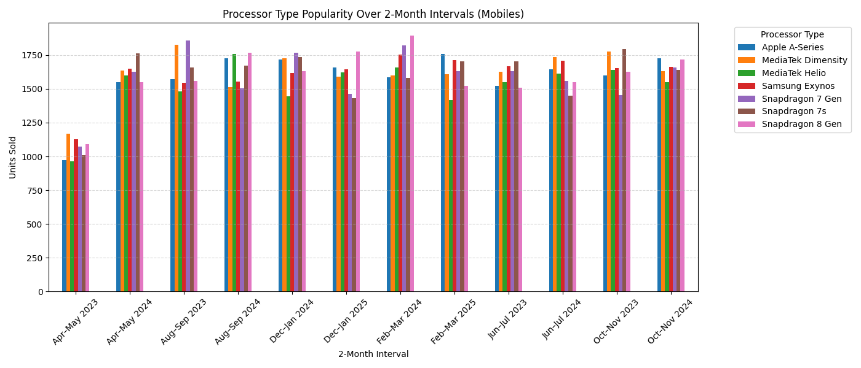

Analyse Processor and Core Popularity Over Time

Slide 26
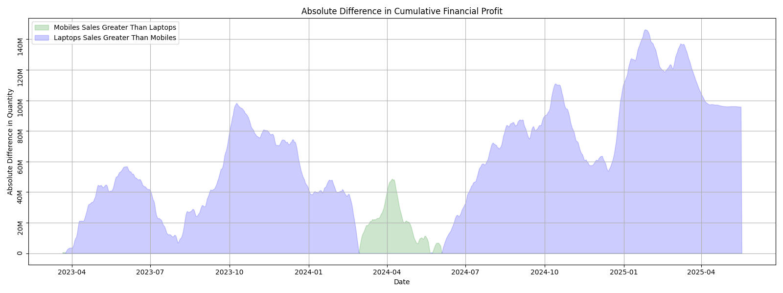
Assess Brand Popularity Over Time

Slide 27




















Assess Brand Popularity Over Time

Slide 28
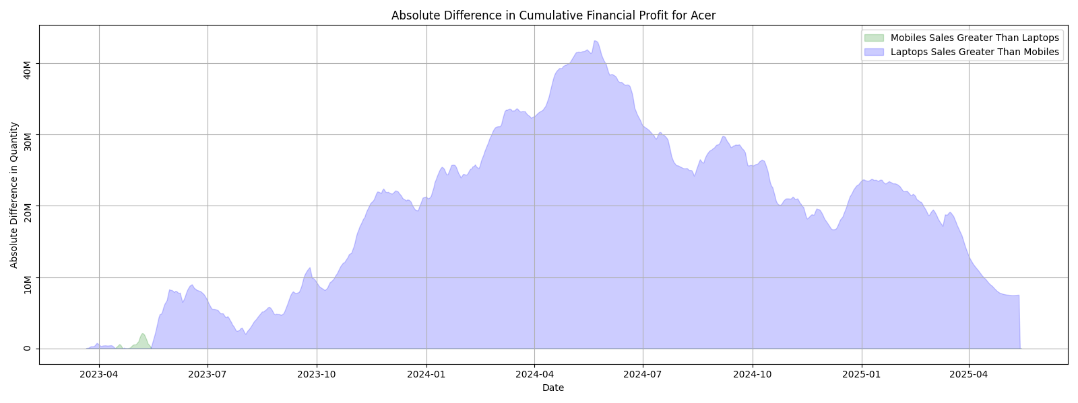
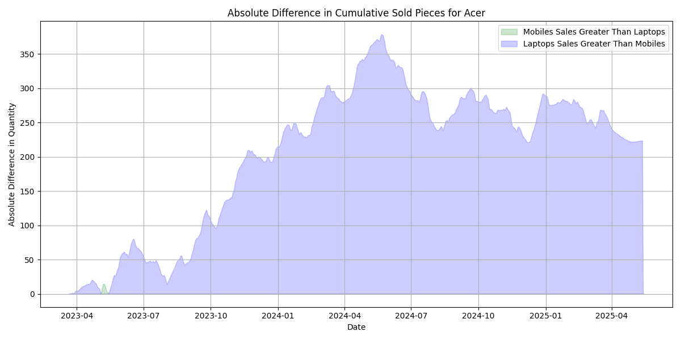
Assess Brand Popularity Over Time

Slide 29
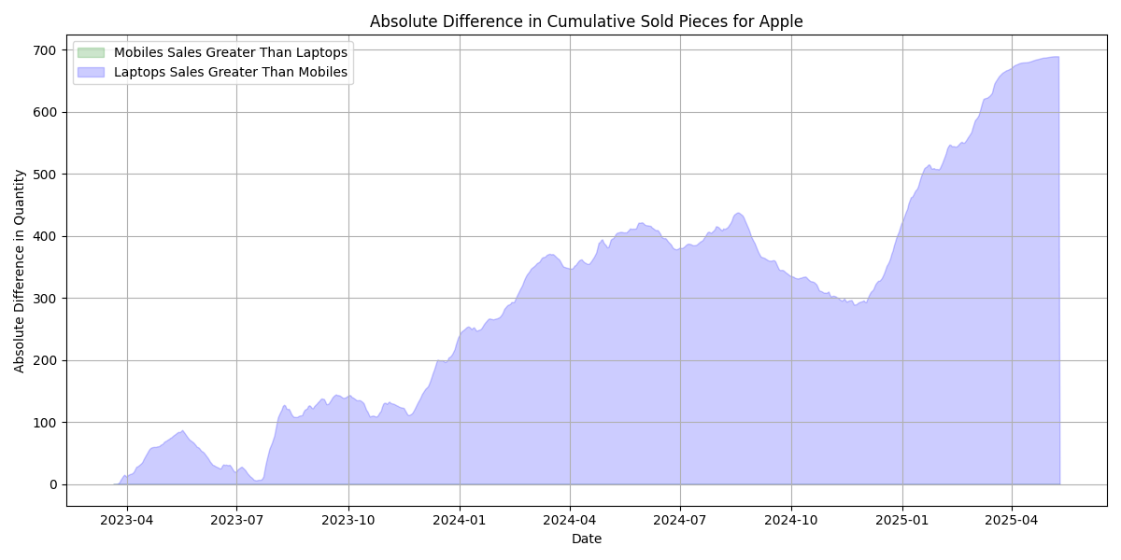
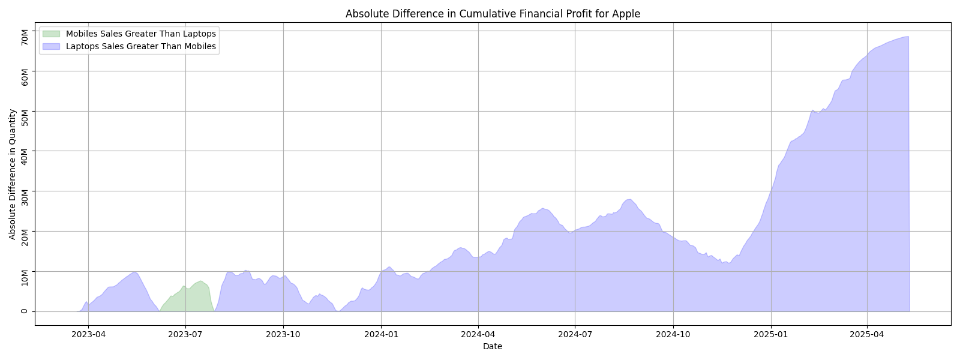
Assess Brand Popularity Over Time

Slide 30
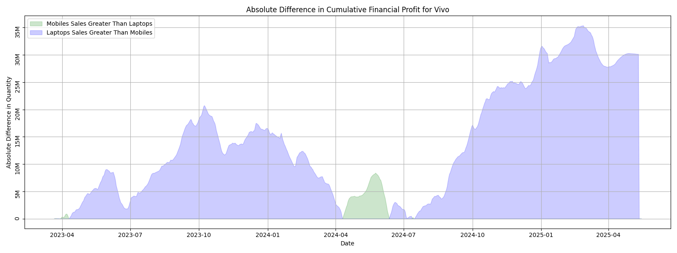
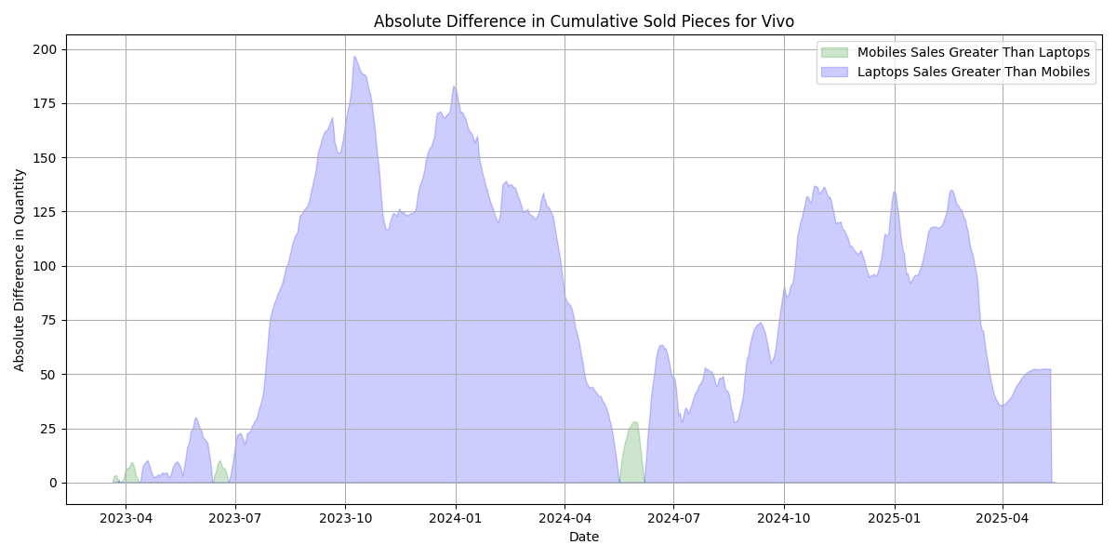
Assess Brand Popularity Over Time

Slide 31
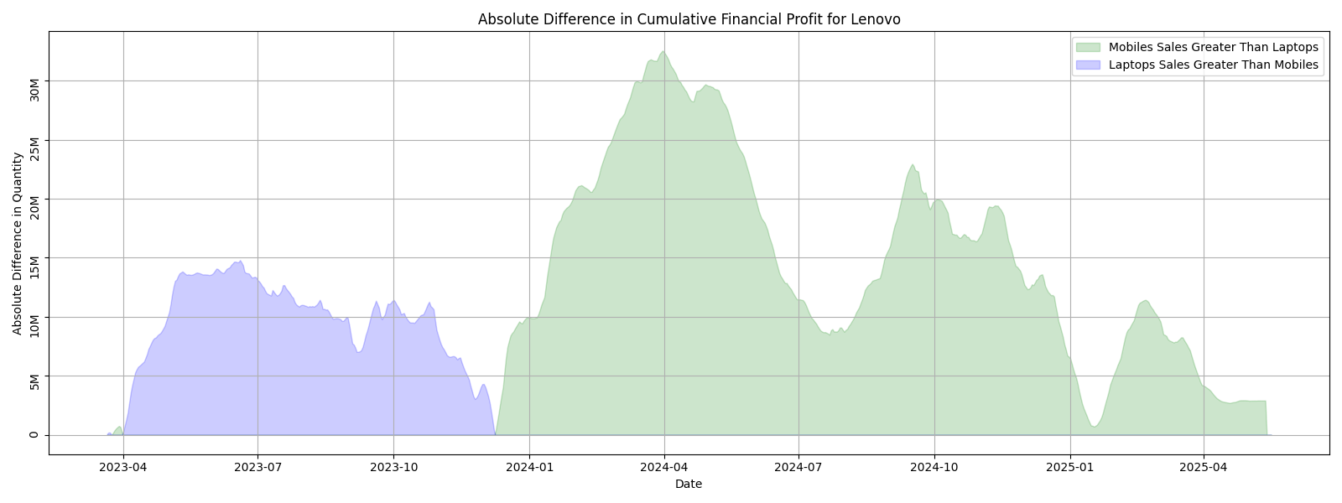
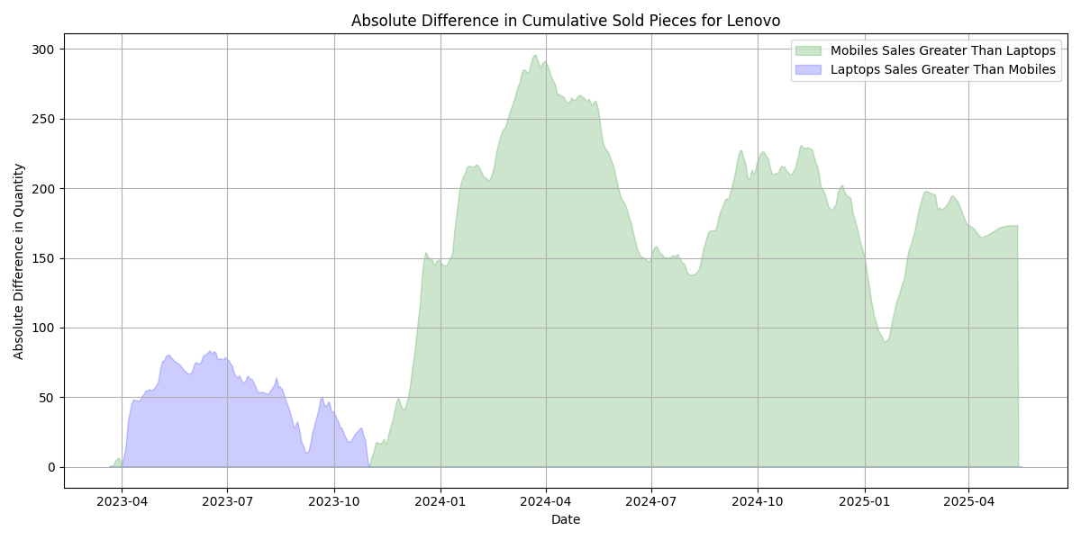
Assess Brand Popularity Over Time

Slide 32
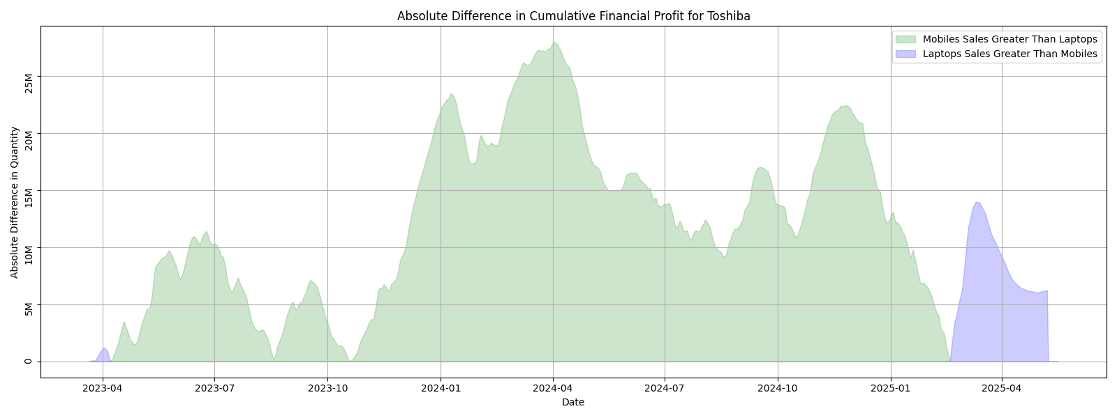
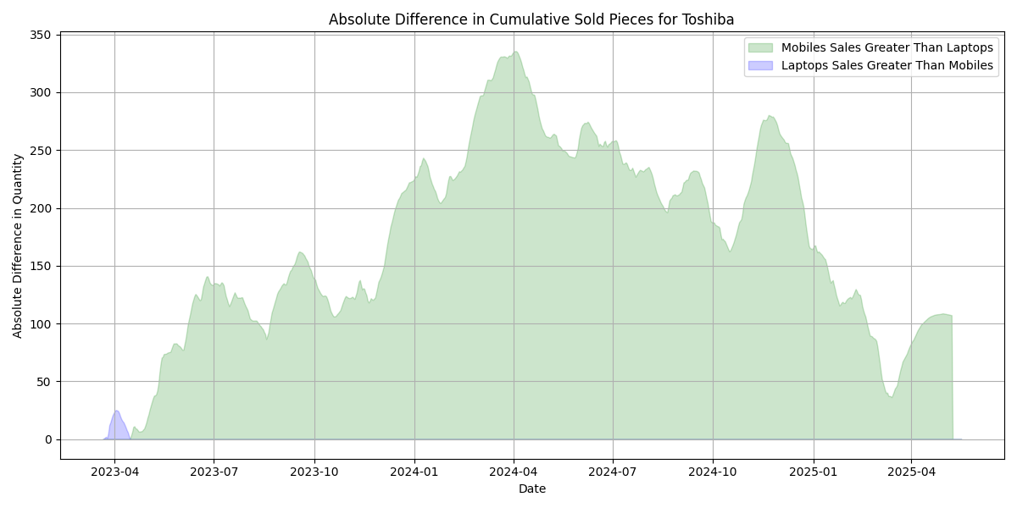
Assess Brand Popularity Over Time

Slide 33
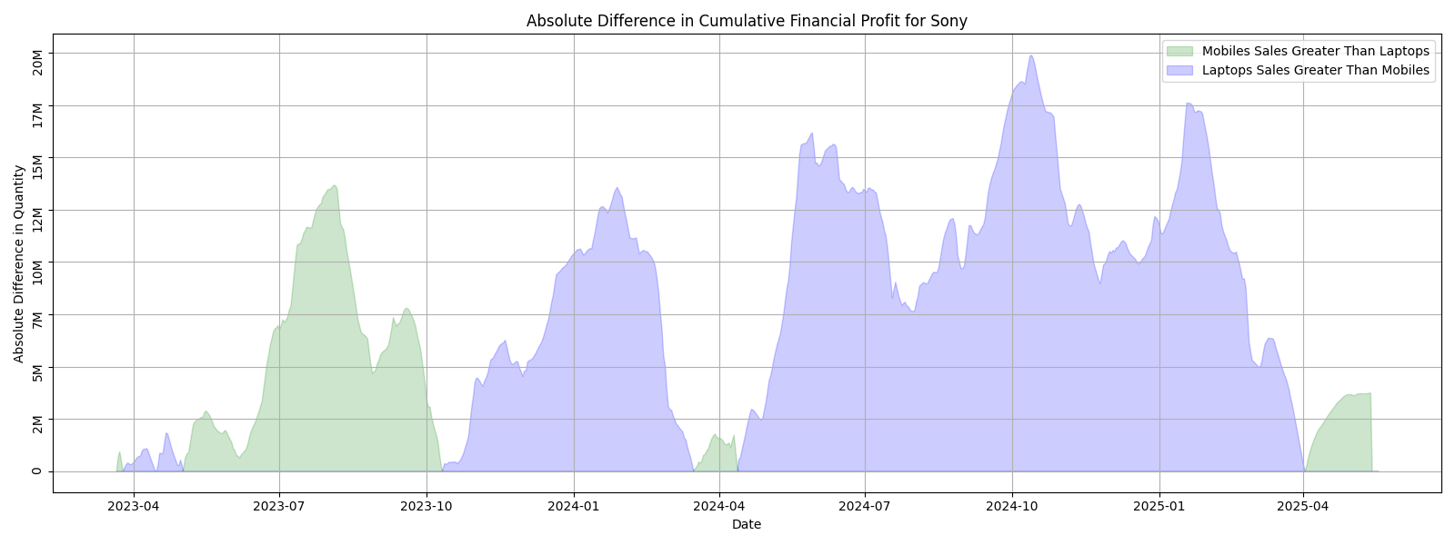
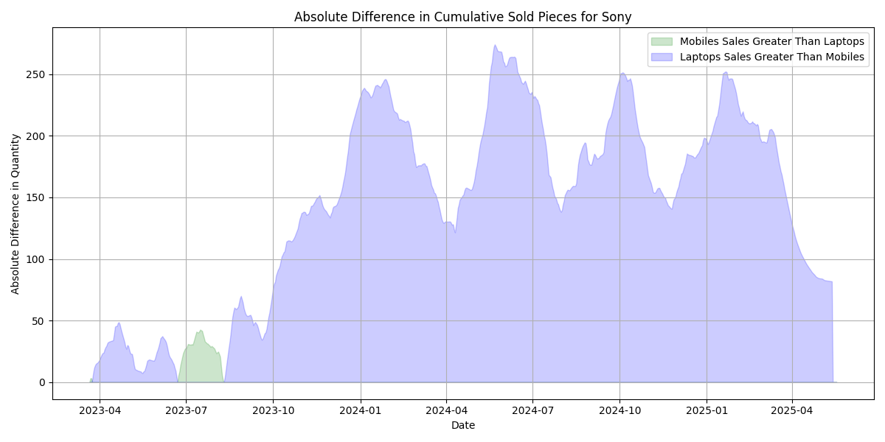
Assess Brand Popularity Over Time

Slide 34
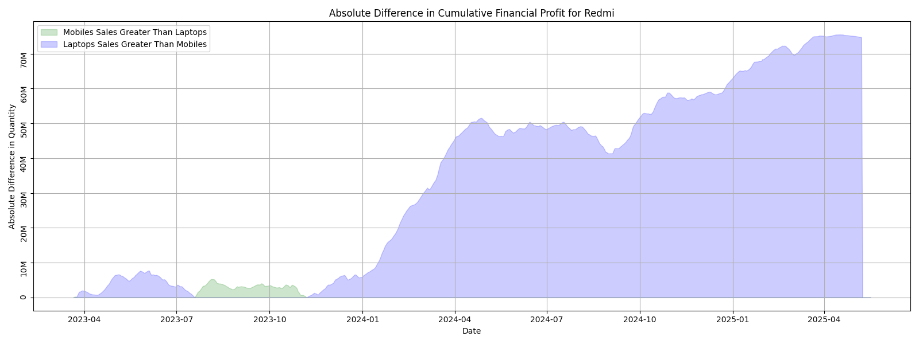
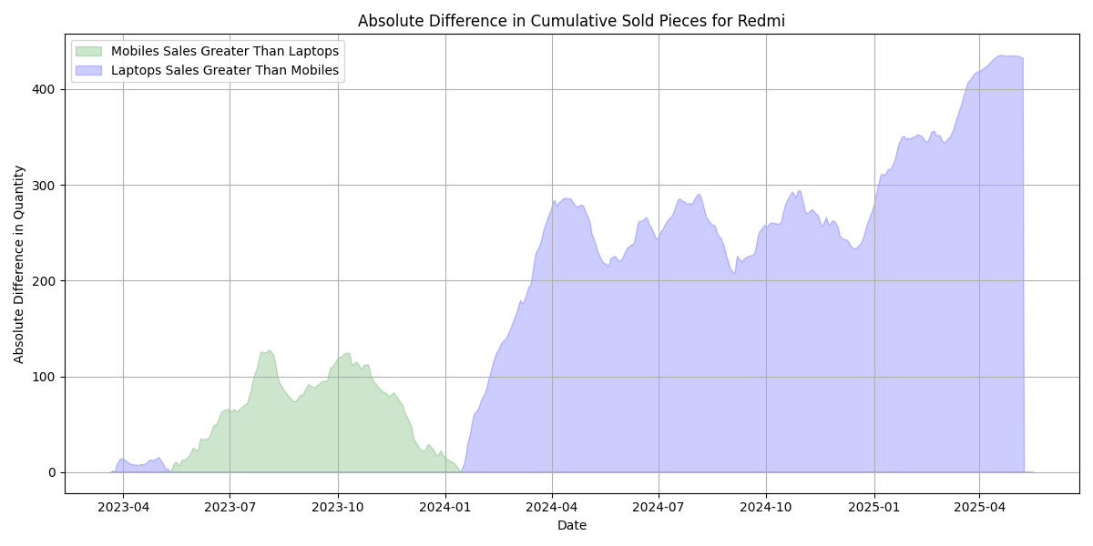
Assess Brand Popularity Over Time

Slide 35
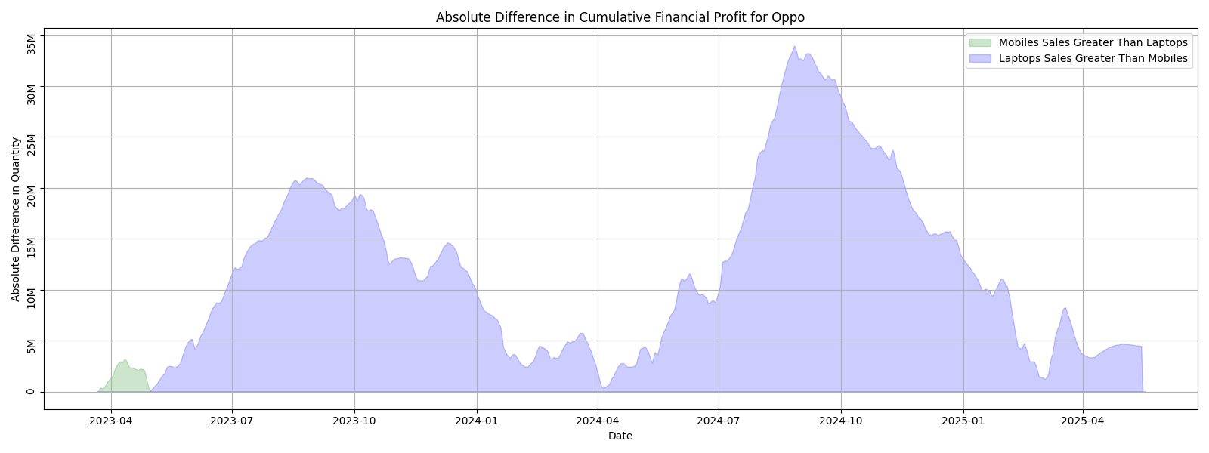
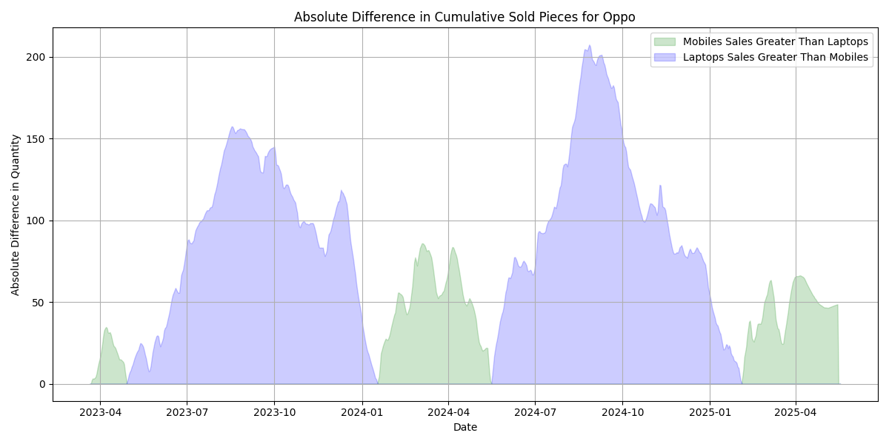
Assess Brand Popularity Over Time

Slide 36
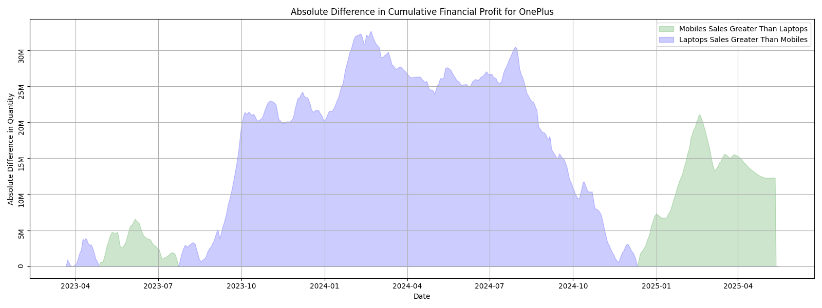
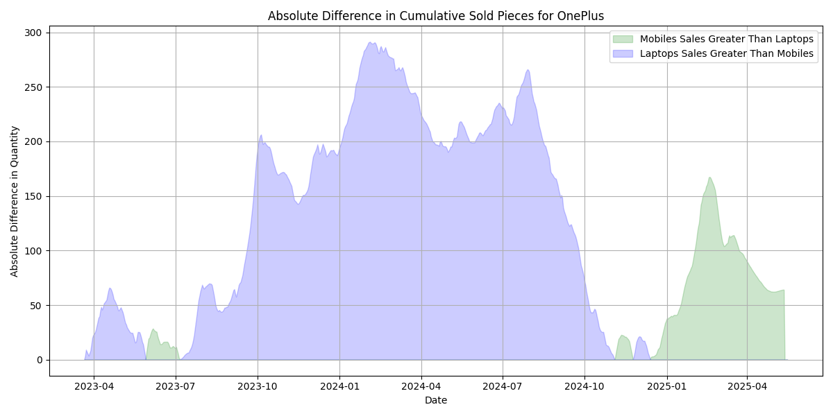
Assess Brand Popularity Over Time

Slide 37
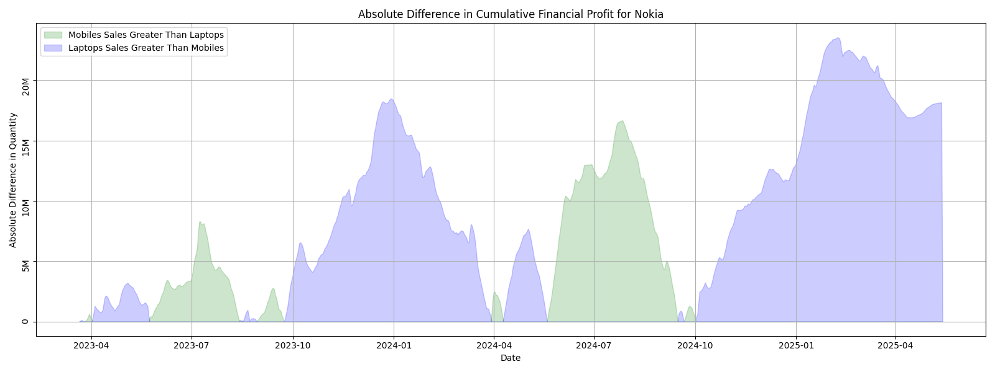
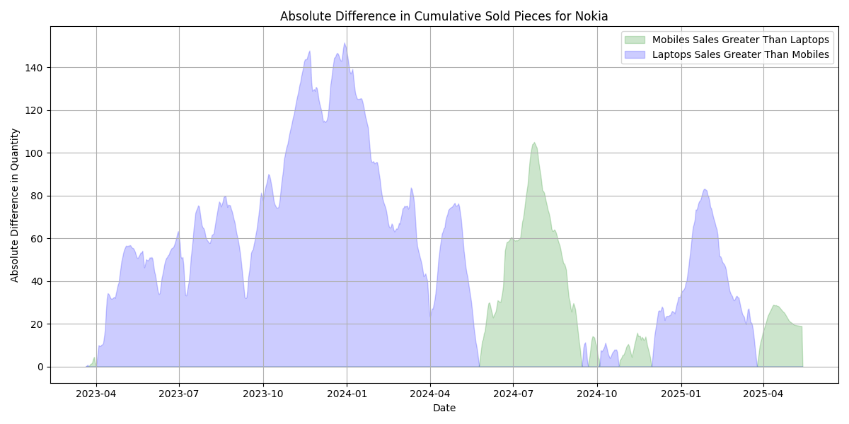
Assess Brand Popularity Over Time

Slide 38
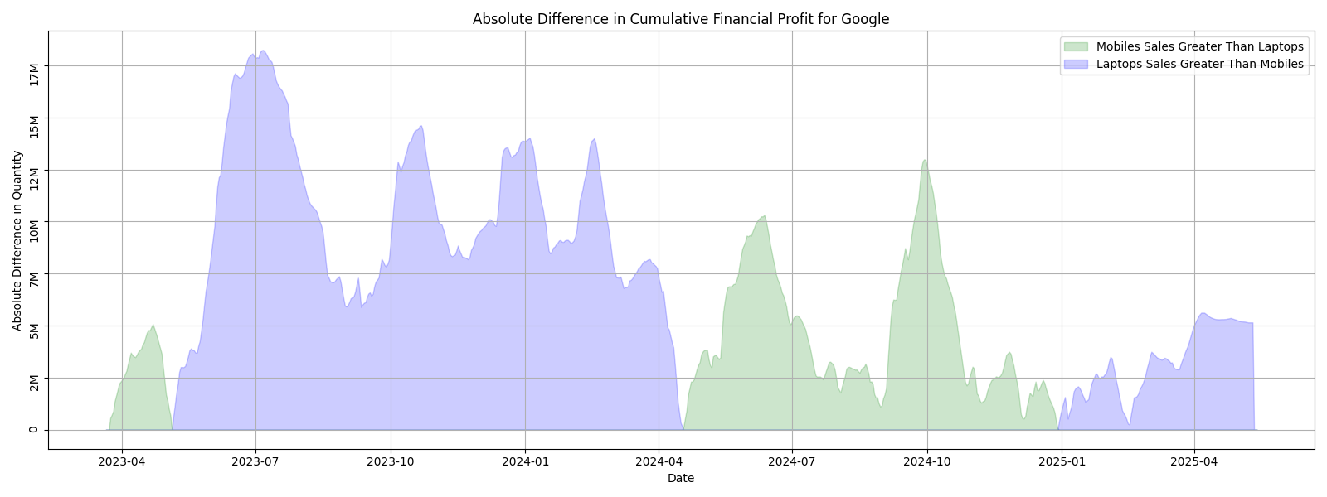
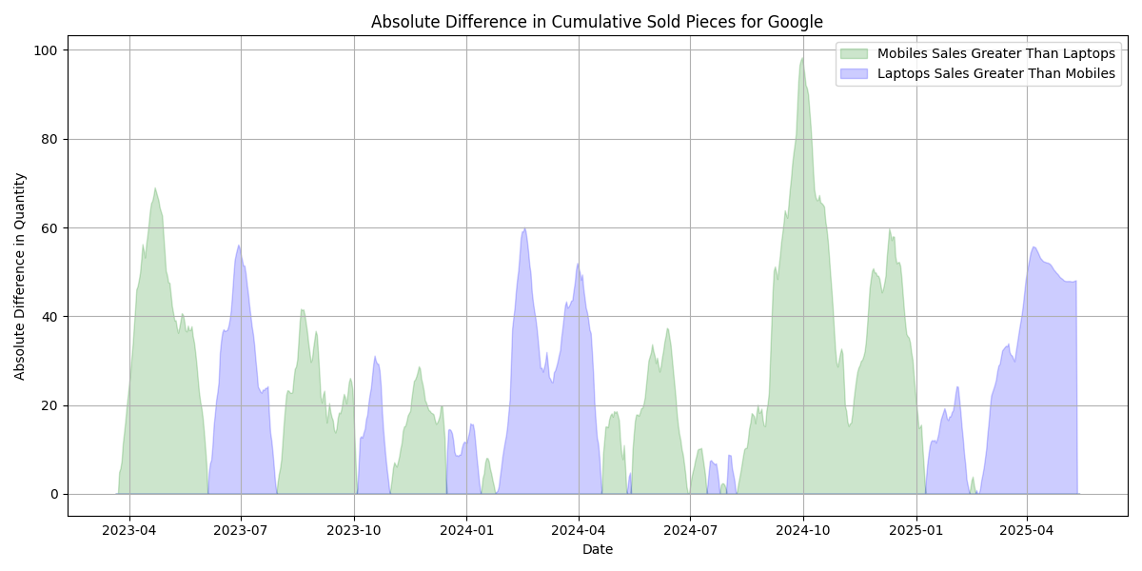
Assess Brand Popularity Over Time

Slide 39
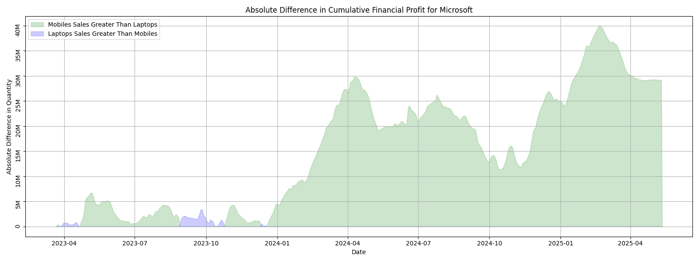
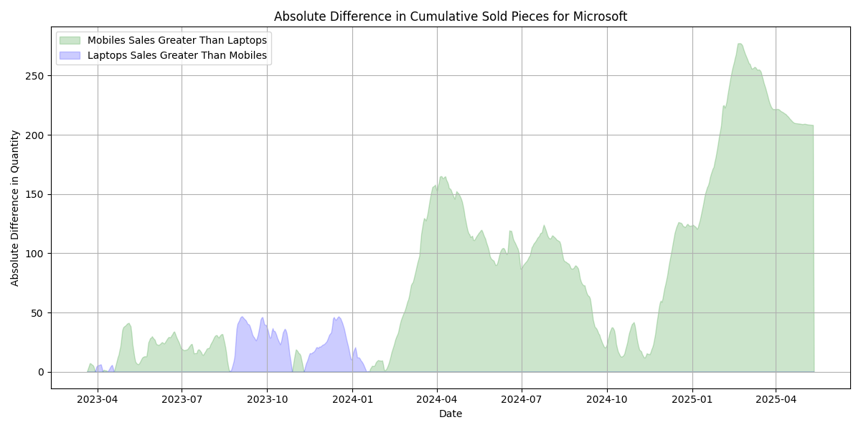
Assess Brand Popularity Over Time

Slide 40
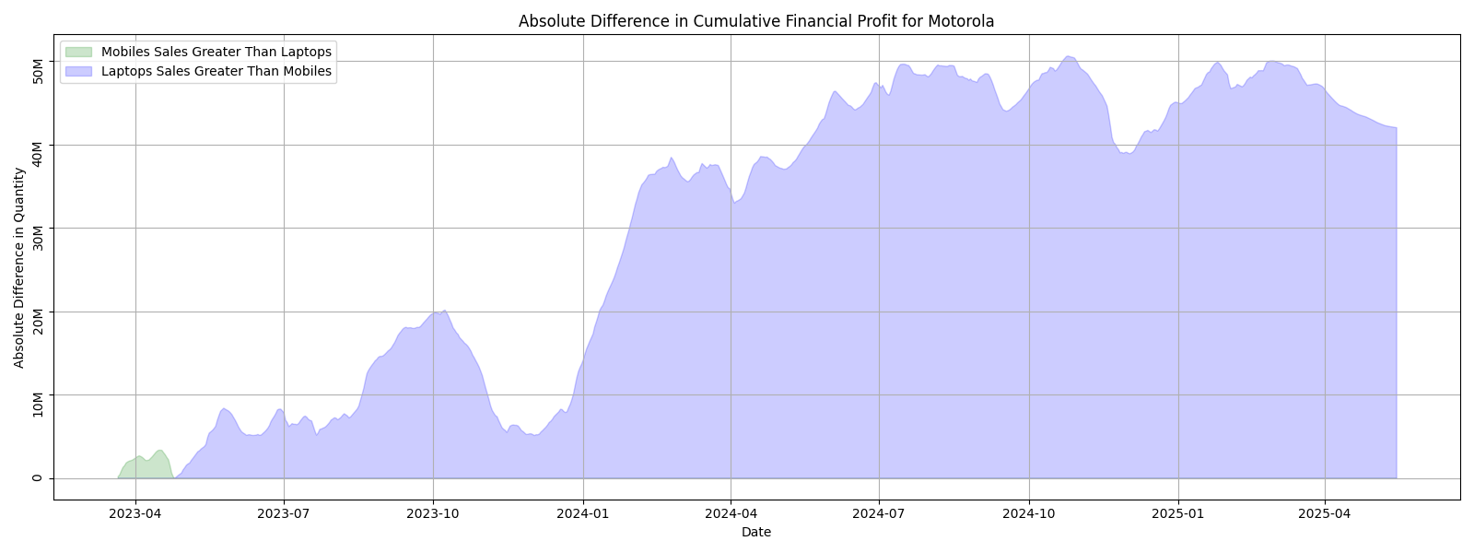
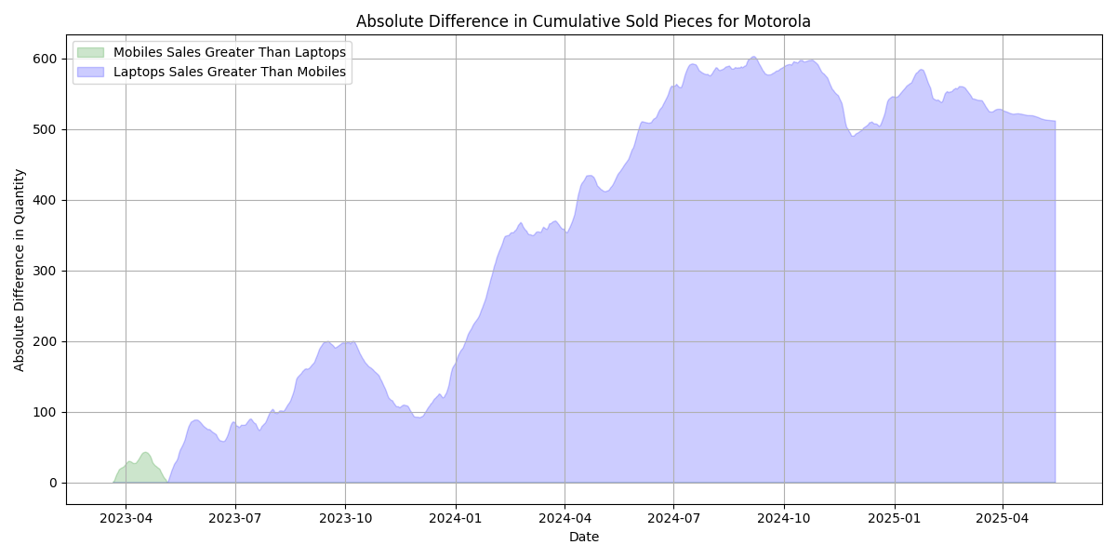
Assess Brand Popularity Over Time

Slide 41
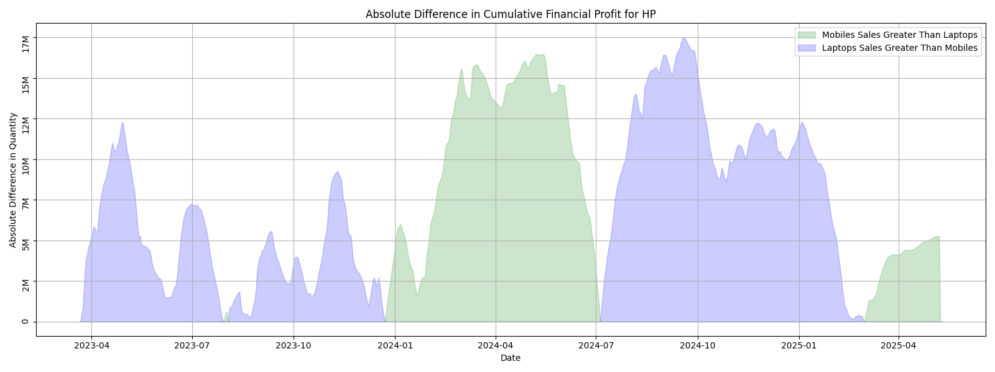

Assess Brand Popularity Over Time

Slide 42


Assess Brand Popularity Over Time

Slide 43


Assess Brand Popularity Over Time

Slide 44


Assess Brand Popularity Over Time

Slide 45


Assess Brand Popularity Over Time

Slide 46


Assess Brand Popularity Over Time

Slide 47


Assess Brand Popularity Over Time

Slide 48
Road Map
Introduction
Dataset Overview
Data Preparation & Cleaning
General Analysis
Deep & Complex Analysis
Insights & Conclusion

Slide 49






Major Findings
Groupby()
1
Summarize data based on groupings.
Pivot Tables
2
Create multi-dimensional tables for cross-tabulation and analysis.
Insights
3
Identify patterns, trends, and relationships within groups.

